Slide 1

Improvi
Go, change the world
RV College of
Engineering
Unit 3(SQL- Schema Definition, Constraints, and Queries and Views)
Original Content: Ramez Elmasri and Shamkant B. Navathe
Dr. Poonam Ghuli
Associate Professor, Department of CSE
RV College of Engineering, Bengaluru - 59

Slide 2

Overview of SQL
Go, change the world
RV College of
Engineering
Structured Query Language (SQL)
DDL + DML
A standard for relational databases
Easily migrate database applications between different relational DBMS
Easily access data stored in different rational DBMS
Evolution
SQL-86 or SQL1
SQL-92 or SQL2
SQL-99

Slide 3
Overview of SQL
Go, change the world
RV College of
Engineering
SQL language may be considered one of the major reasons for the commercial success of relational databases.
it became a standard for relational databases
This is because even if the users became dissatisfied with the particular relational DBMS product they were using,
converting to another relational DBMS product was not expected to be too expensive and time-consuming because both systems followed the same language standards

Slide 4
Overview of SQL
Go, change the world
RV College of
Engineering
Another advantage of having such a standard is that users may write statements in a database application program
that can access data stored in two or more relational DBMSs without having to change the database sublanguage (SQL), as long as both/all of the relational DBMSs support standard SQL.

Slide 5
Overview of SQL
Go, change the world
RV College of
Engineering
This chapter presents the practical relational model, which is based on the SQL standard for commercial relational DBMSs
Previous chapter presented the most important concepts underlying the formal relational data model.
Also discussed the relational algebra operations, which are very important for understanding the types of requests that may be specified on a relational database.
However, the relational algebra operations are too low-level for most commercial DBMS users because a query in relational algebra is written as a sequence of operations that, when executed, produces the required result.

Slide 6
Overview of SQL
Go, change the world
RV College of
Engineering
Hence, the user must specify how—that is, in what order—to execute the query operations.
On the other hand, the SQL language provides a higher-level declarative language interface, so the user only specifies what the result is to be, leaving the actual optimization and decisions on how to execute the query to the DBMS.

Slide 7
Overview of SQL
Go, change the world
RV College of
Engineering
The name SQL is presently expanded as Structured Query Language. Originally, SQL was called SEQUEL (Structured English QUEry Language) and was designed and implemented at IBM Research as the interface for an experimental relational database system called SYSTEM R.
The standardization of SQL is a joint effort by the American National Standards Institute (ANSI) and the International Standards organization (ISO), and the first SQL standard is called SQL-86 or SQL1.

Slide 8
Overview of SQL
Go, change the world
RV College of
Engineering
A revised and much expanded standard called SQL-92 (also referred to as SQL2) was subsequently developed. The next standard that is well-recognized is
SQL:1999, which started out as SQL3.
Additional updates to the standard are SQL:2003 and SQL:2006, which added XML features
Among other updates to the language. Another update in 2008 incorporated more object database features into SQL and a further update is SQL:2011.

Slide 9
Overview of SQL
Go, change the world
RV College of
Engineering
SQL is a comprehensive database language: It has statements for data definitions, queries, and updates.
Hence, it is both a DDL and a DML. In addition, it has facilities for defining views on the database, for specifying security and authorization, for defining integrity constraints, and for specifying transaction controls

Slide 10
SQL Data Definition Statements
Go, change the world
RV College of
Engineering
Used to CREATE, DROP, and ALTER the descriptions of the tables (relations) of a database

Slide 11
Structure of a Database
Go, change the world
RV College of
Engineering
A database system may contain many databases.
Each database is composed of schema and tables.
sql> SHOW databases;
+--------------+
| Database |
+--------------+
| mysql |
| test |
| bank |
| world |
+--------------+
sql> USE bank;
sql> SHOW tables;
+----------------+
| Tables_in_bank |
+----------------+
| accounts |
| clients |
+----------------+
MySQL only shows databases that a user has permission to access.

Slide 12
Structure of a Table
Go, change the world
RV College of
Engineering
Every field has:
a name
a data type and length
To view the structure of a table use:
DESCRIBE tablename;
sql> DESCRIBE City;
+-------------+-----------+-----+-----+---------+----------------+
| Field | Type | Null| Key | Default | Extra |
+-------------+-----------+-----+-----+---------+----------------+
| ID | int(11) | NO | PRI | | auto_increment |
| Name | char(35) | NO | | | |
| CountryCode | char(3) | NO | | | |
| District | char(20) | NO | | | |
| Population | int(11) | NO | | 0 | |
+-------------+-----------+-----+-----+---------+----------------+

Slide 13
SQL Data Definition
Go, change the world
RV College of
Engineering
The main SQL command for data definition is the CREATE statement, which can be used to
create schemas,
tables (relations),
types, and
domains,
as well as other constructs such as views, assertions, and triggers.

Slide 14
CREATE SCHEMA
Go, change the world
RV College of
Engineering
Specifies a new database schema by giving it a name
CREATE SCHEMA COMPANY AUTHORIZATION Jsmith;
In general, not all users are authorized to create schemas and schema elements. The privilege to create schemas, tables, and other constructs must be explicitly granted to the relevant user accounts by the system administrator or DBA.
The concept of an SQL schema was incorporated starting with SQL2 in order to group together tables and other constructs that belong to the same database application (in some systems, a schema is called a database).

Slide 15
CREATE TABLE
Go, change the world
RV College of
Engineering
Specifies a new base relation by giving it a name, and specifying each of its attributes and their data types (INTEGER, FLOAT, DECIMAL(i,j), CHAR(n), VARCHAR(n))
A constraint NOT NULL may be specified on an attribute CREATE TABLE DEPARTMENT ( DNAME VARCHAR(10) NOT NULL, DNUMBER INTEGER NOT NULL, MGRSSN CHAR(9), MGRSTARTDATE CHAR(9) );

Slide 16
CREATE TABLE
Go, change the world
RV College of
Engineering
In SQL2, can use the CREATE TABLE command for specifying the primary key attributes, secondary keys, and referential integrity constraints (foreign keys).
Key attributes can be specified via the PRIMARY KEY and UNIQUE phrases
CREATE TABLE DEPT (
DNAME VARCHAR(10) NOT NULL,
DNUMBER INTEGER NOT NULL,
MGRSSN CHAR(9),
MGRSTARTDATE CHAR(9),
PRIMARY KEY (DNUMBER),
UNIQUE (DNAME),
FOREIGN KEY (MGRSSN) REFERENCES EMP );
Link to specify different constraints with CREATE TABLE
https://www.w3resource.com/mysql/creating-table-advance/constraint.php#cons14

Slide 17
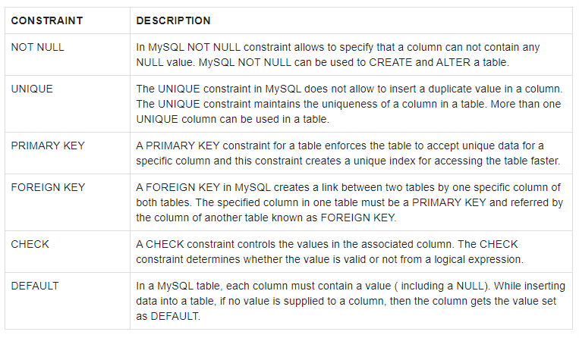
CREATE TABLE
Go, change the world
RV College of
Engineering

Slide 18
REFERENTIAL INTEGRITY OPTIONS
Go, change the world
RV College of
Engineering
We can specify RESTRICT, CASCADE, SET NULL or SET DEFAULT on referential integrity constraints (foreign keys)
CREATE TABLE DEPT ( DNAME VARCHAR(10) NOT NULL, DNUMBER INTEGER NOT NULL, MGRSSN CHAR(9), MGRSTARTDATE CHAR(9), PRIMARY KEY (DNUMBER), UNIQUE (DNAME), FOREIGN KEY (MGRSSN) REFERENCES EMP(ESSN) ON DELETE SET DEFAULT ON UPDATE CASCADE);
Manages : 1:1 relationship type between EMPLOYEE and DEPARTMENT. Employee participation is partial. Department participation is not clear from requirements
are the relationship types observed

Slide 19
REFERENTIAL INTEGRITY OPTIONS (continued)
Go, change the world
RV College of
Engineering
CREATE TABLE EMP(
ENAME VARCHAR(30) NOT NULL, ESSN CHAR(9), BDATE DATE, DNO INTEGER DEFAULT 1, GENDER VARCHAR (9), SUPERSSN CHAR(9), AGE INT NOT NULL,
PRIMARY KEY (ESSN),
FOREIGN KEY (DNO) REFERENCES DEPT(DNUMBER) ON DELETE SET DEFAULT ON UPDATE CASCADE,
FOREIGN KEY (SUPERSSN) REFERENCES EMP(ESSN) ON DELETE SET NULL ON UPDATE CASCADE,
check (GENDER in ('Male', 'Female', 'Unknown')), check (AGE >= 17));

Slide 20
DROP TABLE
Go, change the world
RV College of
Engineering
Used to remove a relation (base table) and its definition
The relation can no longer be used in queries, updates, or any other commands since its description no longer exists
Example:
DROP TABLE table_name;
DROP DATABASE database_name; DROP TABLE DEPENDENT;
A DROP statement in SQL removes a component from a relational database management system (RDBMS).

Slide 21
ALTER TABLE
Go, change the world
RV College of
Engineering
Used to add an attribute to one of the base relations
The new attribute will have NULLs in all the tuples of the relation right after the command is executed; hence, the NOT NULL constraint is not allowed for such an attribute
Example: ALTER TABLE EMPLOYEE ADD JOB VARCHAR(12);
The database users must still enter a value for the new attribute JOB for each EMPLOYEE tuple.
This can be done using the UPDATE command.
Link for Alter Table Commands:
https://www.tutorialspoint.com/sql/sql-alter-command.htm

Slide 22
ALTER TABLE
Go, change the world
RV College of
Engineering
The basic syntax of an ALTER TABLE command to add a New Column in an existing table is as follows.
ALTER TABLE table_name ADD column_name datatype;
The basic syntax of an ALTER TABLE command to DROP COLUMN in an existing table is as follows.
ALTER TABLE table_name DROP COLUMN column_name;

Slide 23
ALTER TABLE
Go, change the world
RV College of
Engineering
The basic syntax of an ALTER TABLE command to add a NOT NULL constraint to a column in a table is as follows.
ALTER TABLE table_name MODIFY column_name datatype NOT NULL;
ALTER TABLE table_name MODIFY column_name datatype NULL;
The basic syntax of ALTER TABLE to ADD UNIQUE CONSTRAINT to a table is as follows.
ALTER TABLE table_name ADD CONSTRAINT MyUniqueConstraint UNIQUE(column1, column2...);
ALTER TABLE Persons DROP INDEX UC_Person;

Slide 24
ALTER TABLE
Go, change the world
RV College of
Engineering
The basic syntax of an ALTER TABLE command to DROP CONSTRAINT from a table is as follows.
ALTER TABLE table_name DROP CONSTRAINT MyUniqueConstraint;
The basic syntax of an ALTER TABLE command to ADD FOREIGN KEY constraint CONSTRAINT from a table is as follows.
ALTER TABLE Orders ADD CONSTRAINT FK_PersonOrder FOREIGN KEY (PersonID) REFERENCES Persons(PersonID);
ALTER TABLE Orders DROP FOREIGN KEY FK_PersonOrder;

Slide 25
ALTER TABLE
Go, change the world
RV College of
Engineering
The basic syntax of an ALTER TABLE command to ADD CHECK CONSTRAINT to a table is as follows.
ALTER TABLE table_name ADD CONSTRAINT MyUniqueConstraint CHECK (CONDITION);
ALTER TABLE Persons DROP CHECK CHK_PersonAge;
The basic syntax of an ALTER TABLE command to ADD PRIMARY KEY constraint to a table is as follows.
ALTER TABLE table_name ADD CONSTRAINT MyPrimaryKey PRIMARY KEY (column1, column2...);
ALTER TABLE Persons DROP PRIMARY KEY;

Slide 26
ALTER TABLE
Go, change the world
RV College of
Engineering
The basic syntax of an ALTER TABLE command to ADD and DROP DEFAULT CONSTRAINT to a table is as follows.
ALTER TABLE Persons ALTER City SET DEFAULT 'Sandnes';
ALTER TABLE Persons ALTER City DROP DEFAULT;
The basic syntax of an ALTER TABLE command to change the DATA TYPE of a column in a table is as follows.
ALTER TABLE table_name MODIFY COLUMN column_name datatype;

Slide 27
INSERT statement
Go, change the world
RV College of
Engineering
The INSERT statement allows you to insert one or more rows into a table. The following illustrates the syntax of the INSERT statement
INSERT INTO tablename (c1,c2,...)
VALUES (v1,v2,...);
INSERT INTO tablename
VALUES (v1,v2,...);

Slide 28
INSERT statement
Go, change the world
RV College of
Engineering
To insert multiple rows into a table using a single INSERT statement, you use the following syntax:
INSERT INTO tablename (c1,c2,...)
VALUES
(v11,v12,...),
(v21,v22,...),
... (vnn,vn2,...);

Slide 29
Additional Data Types in SQL2 and SQL-99
Go, change the world
RV College of
Engineering
Has DATE, TIME, and TIMESTAMP data types
DATE:
Made up of year-month-day in the format yyyy-mm-dd
TIME:
Made up of hour:minute:second in the format hh:mm:ss
TIME(i):
Made up of hour:minute:second plus i additional digits specifying fractions of a second
format is hh:mm:ss:ii...i
Manages : 1:1 relationship type between EMPLOYEE and DEPARTMENT. Employee participation is partial. Department participation is not clear from requirements
are the relationship types observed

Slide 30
Retrieval Queries in SQL
Go, change the world
RV College of
Engineering
SQL has one basic statement for retrieving information from a database; the SELECT statement
This is not the same as the SELECT operation of the relational algebra
Important distinction between SQL and the formal relational model:
SQL allows a table (relation) to have two or more tuples that are identical in all their attribute values
Hence, an SQL relation (table) is a multi-set (sometimes called a bag) of tuples; it is not a set of tuples
SQL relations can be constrained to be sets by specifying PRIMARY KEY or UNIQUE attributes, or by using the DISTINCT option in a query
Manages : 1:1 relationship type between EMPLOYEE and DEPARTMENT. Employee participation is partial. Department participation is not clear from requirements
are the relationship types observed

Slide 31
Retrieval Queries in SQL (contd.)
Go, change the world
RV College of
Engineering
A bag or multi-set is like a set, but an element may appear more than once.
Example: {A, B, C, A} is a bag. {A, B, C} is also a bag that also is a set.
Bags also resemble lists, but the order is irrelevant in a bag.
Example:
{A, B, A} = {B, A, A} as bags
However, [A, B, A] is not equal to [B, A, A] as lists
Manages : 1:1 relationship type between EMPLOYEE and DEPARTMENT. Employee participation is partial. Department participation is not clear from requirements
are the relationship types observed

Slide 32
Retrieval Queries in SQL (contd.)
Go, change the world
RV College of
Engineering
Basic form of the SQL SELECT statement is called a mapping or a SELECT-FROM-WHERE block
SELECT <attribute list>
FROM <table list>
WHERE <condition>
<attribute list> is a list of attribute names whose values are to be retrieved by the query
<table list> is a list of the relation names required to process the query
<condition> is a conditional (Boolean) expression that identifies the tuples to be retrieved by the query

Slide 33
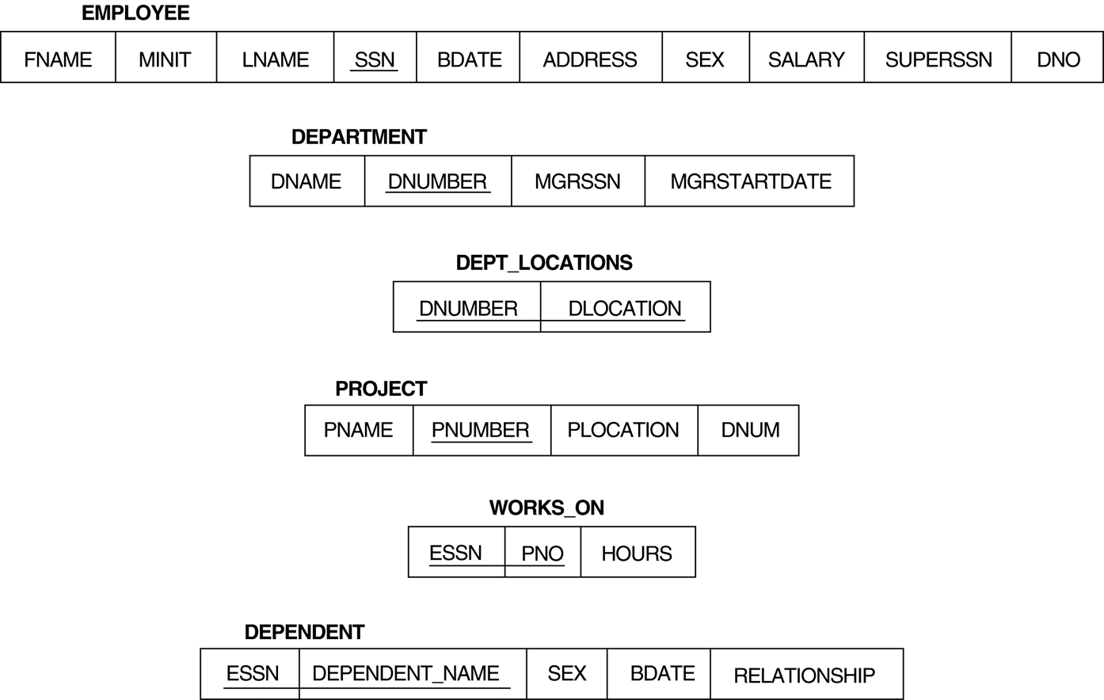
Relational Database Schema
Go, change the world
RV College of
Engineering
Manages : 1:1 relationship type between EMPLOYEE and DEPARTMENT. Employee participation is partial. Department participation is not clear from requirements
are the relationship types observed

Slide 34
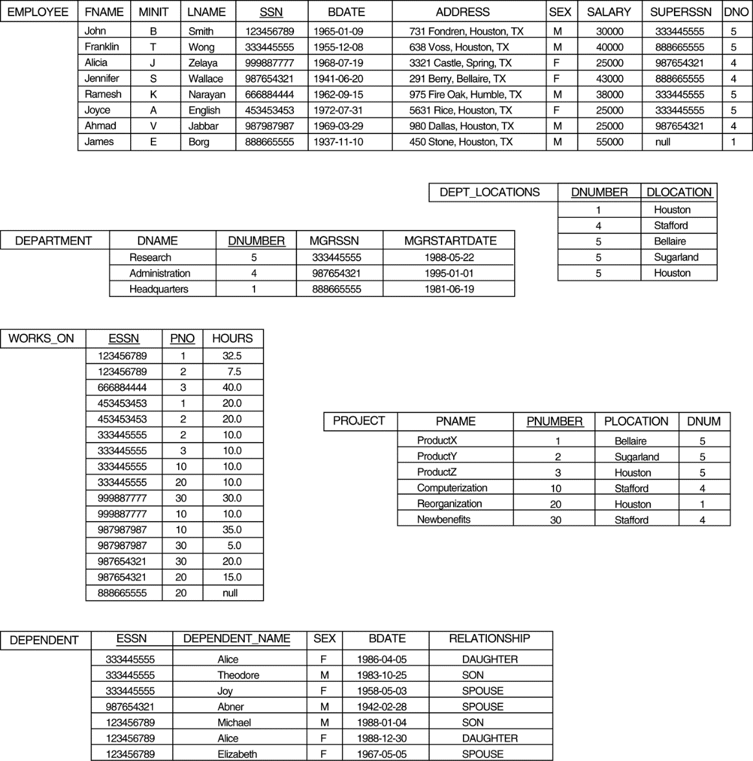
Populated Database
Go, change the world
RV College of
Engineering
Manages : 1:1 relationship type between EMPLOYEE and DEPARTMENT. Employee participation is partial. Department participation is not clear from requirements
are the relationship types observed

Slide 35
Simple SQL Queries
Go, change the world
RV College of
Engineering
Basic SQL queries correspond to using the following operations of the relational algebra:
SELECT
PROJECT
JOIN
All subsequent examples use the COMPANY database
Manages : 1:1 relationship type between EMPLOYEE and DEPARTMENT. Employee participation is partial. Department participation is not clear from requirements
are the relationship types observed

Slide 36
Simple SQL Queries (contd.)
Go, change the world
RV College of
Engineering
Example of a simple query on one relation
Query 0: Retrieve the birthdate and address of the employee whose name is 'John B. Smith'.
Q0: SELECT BDATE, ADDRESS FROM EMPLOYEE WHERE FNAME='John' AND MINIT='B’ AND LNAME='Smith’
Similar to a SELECT-PROJECT pair of relational algebra operations:
The SELECT-clause specifies the projection attributes and the WHERE-clause specifies the selection condition
However, the result of the query may contain duplicate tuples
Manages : 1:1 relationship type between EMPLOYEE and DEPARTMENT. Employee participation is partial. Department participation is not clear from requirements

Slide 37
Simple SQL Queries (contd.)
Go, change the world
RV College of
Engineering
Query 1: Retrieve the name and address of all employees who work for the 'Research' department.
Q1: SELECT FNAME, LNAME, ADDRESS FROM EMPLOYEE, DEPARTMENT WHERE DNAME='Research' AND DNUMBER=DNO
Similar to a SELECT-PROJECT-JOIN sequence of relational algebra operations
(DNAME='Research') is a selection condition (corresponds to a SELECT operation in relational algebra)
(DNUMBER=DNO) is a join condition (corresponds to a JOIN operation in relational algebra)

Slide 38
Simple SQL Queries (contd.)
Go, change the world
RV College of
Engineering
Query 2: For every project located in 'Stafford', list the project number, the controlling department number, and the department manager's last name, address, and birthdate.
Q2: SELECT PNUMBER, DNUM, LNAME, BDATE, ADDRESS FROM PROJECT, DEPARTMENT, EMPLOYEE WHERE DNUM=DNUMBER AND MGRSSN=SSN AND PLOCATION='Stafford'
In Q2, there are two join conditions
The join condition DNUM=DNUMBER relates a project to its controlling department
The join condition MGRSSN=SSN relates the controlling department to the employee who manages that department
Manages : 1:1 relationship type between EMPLOYEE and DEPARTMENT. Employee participation is partial. Department participation is not clear from requirements
are the relationship types observed

Slide 39
Aliases, * and DISTINCT, Empty WHERE-clause
Go, change the world
RV College of
Engineering
In SQL, we can use the same name for two (or more) attributes as long as the attributes are in different relations
A query that refers to two or more attributes with the same name must qualify the attribute name with the relation name by prefixing the relation name to the attribute name
Example:
EMPLOYEE.LNAME, DEPARTMENT.DNAME
Manages : 1:1 relationship type between EMPLOYEE and DEPARTMENT. Employee participation is partial. Department participation is not clear from requirements
are the relationship types observed

Slide 40
ALIASES
Go, change the world
RV College of
Engineering
Some queries need to refer to the same relation twice
In this case, aliases are given to the relation name
Query 8: For each employee, retrieve the employee's name, and the name of his or her immediate supervisor. Q8: SELECT E.FNAME, E.LNAME, S.FNAME, S.LNAME FROM EMPLOYEE E S WHERE E.SUPERSSN=S.SSN
In Q8, the alternate relation names E and S are called aliases or tuple variables for the EMPLOYEE relation
We can think of E and S as two different copies of EMPLOYEE; E represents employees in role of supervisees and S represents employees in role of supervisors

Slide 41
ALIASES (contd.)
Go, change the world
RV College of
Engineering
Aliasing can also be used in any SQL query for convenience
Can also use the AS keyword to specify aliases
Q8: SELECT E.FNAME, E.LNAME,
S.FNAME, S.LNAME FROM EMPLOYEE AS E,
EMPLOYEE AS S WHERE E.SUPERSSN=S.SSN
Manages : 1:1 relationship type between EMPLOYEE and DEPARTMENT. Employee participation is partial. Department participation is not clear from requirements
are the relationship types observed

Slide 42
UNSPECIFIED WHERE-clause
Go, change the world
RV College of
Engineering
A missing WHERE-clause indicates no condition; hence, all tuples of the relations in the FROM-clause are selected
This is equivalent to the condition WHERE TRUE
Query 9: Retrieve the SSN values for all employees.
Q9: SELECT SSN FROM EMPLOYEE
If more than one relation is specified in the FROM-clause and there is no join condition, then the CARTESIAN PRODUCT of tuples is selected
Manages : 1:1 relationship type between EMPLOYEE and DEPARTMENT. Employee participation is partial. Department participation is not clear from requirements
are the relationship types observed

Slide 43
UNSPECIFIED WHERE-clause (contd.)
Go, change the world
RV College of
Engineering
Example:
Q10: SELECT SSN, DNAME FROM EMPLOYEE, DEPARTMENT
It is extremely important not to overlook specifying any selection and join conditions in the WHERE-clause; otherwise, incorrect and very large relations may result
Manages : 1:1 relationship type between EMPLOYEE and DEPARTMENT. Employee participation is partial. Department participation is not clear from requirements
are the relationship types observed

Slide 44
USE OF *
Go, change the world
RV College of
Engineering
To retrieve all the attribute values of the selected tuples, a * is used, which stands for all the attributes Examples:
Q1C: SELECT * FROM EMPLOYEE WHERE DNO=5 Q1D: SELECT * FROM EMPLOYEE, DEPARTMENT WHERE DNAME='Research' AND DNO=DNUMBER
Manages : 1:1 relationship type between EMPLOYEE and DEPARTMENT. Employee participation is partial. Department participation is not clear from requirements
are the relationship types observed

Slide 45
USE OF DISTINCT
Go, change the world
RV College of
Engineering
SQL does not treat a relation as a set; duplicate tuples can appear
To eliminate duplicate tuples in a query result, the keyword DISTINCT is used
For example, the result of Q11 may have duplicate SALARY values whereas Q11A does not have any duplicate values
Q11: SELECT SALARY FROM EMPLOYEE
Q11A: SELECT DISTINCT SALARY FROM EMPLOYEE
Manages : 1:1 relationship type between EMPLOYEE and DEPARTMENT. Employee participation is partial. Department participation is not clear from requirements

Slide 46
SET OPERATIONS
Go, change the world
RV College of
Engineering
SQL has directly incorporated some set operations
There is a union operation (UNION), and in some versions of SQL there are set difference (MINUS) and intersection (INTERSECT) operations
The resulting relations of these set operations are sets of tuples; duplicate tuples are eliminated from the result
The set operations apply only to union compatible relations; the two relations must have the same attributes and the attributes must appear in the same order
Manages : 1:1 relationship type between EMPLOYEE and DEPARTMENT. Employee participation is partial. Department participation is not clear from requirements
are the relationship types observed

Slide 47
SET OPERATIONS (contd.)
Go, change the world
RV College of
Engineering
Query 4: Make a list of all project names for projects that involve an employee whose last name is 'Smith' as a worker or as a manager of the department that controls the project.
Q4: (SELECT PNAME FROM PROJECT, DEPARTMENT, EMPLOYEE WHERE DNUM=DNUMBER AND MGRSSN=SSN AND LNAME='Smith') UNION
(SELECT PNAME FROM PROJECT, WORKS_ON, EMPLOYEE WHERE PNUMBER=PNO AND ESSN=SSN AND NAME='Smith')
Manages : 1:1 relationship type between EMPLOYEE and DEPARTMENT. Employee participation is partial. Department participation is not clear from requirements
are the relationship types observed

Slide 48
NESTING OF QUERIES
Go, change the world
RV College of
Engineering
A complete SELECT query, called a nested query, can be specified within the WHERE-clause of another query, called the outer query
Many of the previous queries can be specified in an alternative form using nesting
Query 1: Retrieve the name and address of all employees who work for the 'Research' department.
Q1: SELECT FNAME, LNAME, ADDRESS FROM EMPLOYEE WHERE DNO IN (SELECT DNUMBER FROM DEPARTMENT WHERE DNAME='Research' )
Manages : 1:1 relationship type between EMPLOYEE and DEPARTMENT. Employee participation is partial. Department participation is not clear from requirements
are the relationship types observed

Slide 49
NESTING OF QUERIES (contd.)
Go, change the world
RV College of
Engineering
The nested query selects the number of the 'Research' department
The outer query select an EMPLOYEE tuple if its DNO value is in the result of either nested query
The comparison operator IN compares a value v with a set (or multi-set) of values V, and evaluates to TRUE if v is one of the elements in V
In general, we can have several levels of nested queries
A reference to an unqualified attribute refers to the relation declared in the innermost nested query
In this example, the nested query is not correlated with the outer query
Manages : 1:1 relationship type between EMPLOYEE and DEPARTMENT. Employee participation is partial. Department participation is not clear from requirements
are the relationship types observed

Slide 50
CORRELATED NESTED QUERIES
Go, change the world
RV College of
Engineering
If a condition in the WHERE-clause of a nested query references an attribute of a relation declared in the outer query, the two queries are said to be correlated
The result of a correlated nested query is different for each tuple (or combination of tuples) of the relation(s) the outer query
Query 12: Retrieve the name of each employee who has a dependent with the same first name as the employee. Q12: SELECT E.FNAME, E.LNAME FROM EMPLOYEE AS E WHERE E.SSN IN (SELECT ESSN FROM DEPENDENT WHERE ESSN=E.SSN AND E.FNAME=DEPENDENT_NAME)
Manages : 1:1 relationship type between EMPLOYEE and DEPARTMENT. Employee participation is partial. Department participation is not clear from requirements

Slide 51
CORRELATED NESTED QUERIES (contd.)
Go, change the world
RV College of
Engineering
In Q12, the nested query has a different result in the outer query
A query written with nested SELECT... FROM... WHERE... blocks and using the = or IN comparison operators can always be expressed as a single block query. For example, Q12 may be written as in Q12A
Q12A: SELECT E.FNAME, E.LNAME FROM EMPLOYEE E, DEPENDENT D WHERE E.SSN=D.ESSN AND
E.FNAME=D.DEPENDENT_NAME
Manages : 1:1 relationship type between EMPLOYEE and DEPARTMENT. Employee participation is partial. Department participation is not clear from requirements
are the relationship types observed

Slide 52
CORRELATED NESTED QUERIES (contd.)
Go, change the world
RV College of
Engineering
The original SQL as specified for SYSTEM R also had a CONTAINS comparison operator, which is used in conjunction with nested correlated queries
This operator was dropped from the language, possibly because of the difficulty in implementing it efficiently
Most implementations of SQL do not have this operator
The CONTAINS operator compares two sets of values, and returns TRUE if one set contains all values in the other set
Reminiscent of the division operation of algebra
Manages : 1:1 relationship type between EMPLOYEE and DEPARTMENT. Employee participation is partial. Department participation is not clear from requirements
are the relationship types observed

Slide 53
CORRELATED NESTED QUERIES (contd.)
Go, change the world
RV College of
Engineering
Query 3: Retrieve the name of each employee who works on all the projects controlled by department number 5.
Q3: SELECT FNAME, LNAME FROM EMPLOYEE WHERE ( (SELECT PNO FROM WORKS_ON WHERE SSN=ESSN) CONTAINS (SELECT PNUMBER FROM PROJECT WHERE DNUM=5) )
Manages : 1:1 relationship type between EMPLOYEE and DEPARTMENT. Employee participation is partial. Department participation is not clear from requirements
are the relationship types observed

Slide 54
CORRELATED NESTED QUERIES (contd.)
Go, change the world
RV College of
Engineering
In Q3, the second nested query, which is not correlated with the outer query, retrieves the project numbers of all projects controlled by department 5
The first nested query, which is correlated, retrieves the project numbers on which the employee works, which is different for each employee tuple because of the correlation
Manages : 1:1 relationship type between EMPLOYEE and DEPARTMENT. Employee participation is partial. Department participation is not clear from requirements
are the relationship types observed

Slide 55
THE EXISTS FUNCTION
Go, change the world
RV College of
Engineering
EXISTS is used to check whether the result of a correlated nested query is empty (contains no tuples) or not
We can formulate Query 12 in an alternative form that uses EXISTS as Q12B
Manages : 1:1 relationship type between EMPLOYEE and DEPARTMENT. Employee participation is partial. Department participation is not clear from requirements
are the relationship types observed

Slide 56
THE EXISTS FUNCTION (contd.)
Go, change the world
RV College of
Engineering
Query 12: Retrieve the name of each employee who has a dependent with the same first name as the employee.
Q12B: SELECT FNAME, LNAME FROM EMPLOYEE WHERE EXISTS (SELECT * FROM DEPENDENT WHERE SSN=ESSN AND FNAME=DEPENDENT_NAME)
Manages : 1:1 relationship type between EMPLOYEE and DEPARTMENT. Employee participation is partial. Department participation is not clear from requirements
are the relationship types observed

Slide 57
THE EXISTS FUNCTION (contd.)
Go, change the world
RV College of
Engineering
Query 6: Retrieve the names of employees who have no dependents.
Q6: SELECT FNAME, LNAME FROM EMPLOYEE WHERE NOT EXISTS (SELECT * FROM DEPENDENT WHERE SSN=ESSN)
In Q6, the correlated nested query retrieves all DEPENDENT tuples related to an EMPLOYEE tuple. If none exist, the EMPLOYEE tuple is selected
EXISTS is necessary for the expressive power of SQL
Manages : 1:1 relationship type between EMPLOYEE and

Slide 58
EXPLICIT SETS
Go, change the world
RV College of
Engineering
It is also possible to use an explicit (enumerated) set of values in the WHERE-clause rather than a nested query
Query 13: Retrieve the social security numbers of all employees who work on project number 1, 2, or 3.
Q13: SELECT DISTINCT ESSN FROM WORKS_ON WHERE PNO IN (1, 2, 3)
Manages : 1:1 relationship type between EMPLOYEE and DEPARTMENT. Employee participation is partial. Department participation is not clear from requirements

Slide 59
NULLS IN SQL QUERIES
Go, change the world
RV College of
Engineering
SQL allows queries that check if a value is NULL (missing or undefined or not applicable)
SQL uses IS or IS NOT to compare NULLs because it considers each NULL value distinct from other NULL values, so equality comparison is not appropriate.
Query 14: Retrieve the names of all employees who do not have supervisors.
Q14: SELECT FNAME, LNAME FROM EMPLOYEE WHERE SUPERSSN IS NULL
Note: If a join condition is specified, tuples with NULL values for the join attributes are not included in the result
Manages : 1:1 relationship type between EMPLOYEE and DEPARTMENT. Employee participation is partial. Department participation is

Slide 60
Joined Relations Feature in SQL2
Go, change the world
RV College of
Engineering
Can specify a "joined relation" in the FROM-clause
Looks like any other relation but is the result of a join
Allows the user to specify different types of joins (regular "theta" JOIN, NATURAL JOIN, LEFT OUTER JOIN, RIGHT OUTER JOIN, CROSS JOIN, etc)
Manages : 1:1 relationship type between EMPLOYEE and DEPARTMENT. Employee participation is partial. Department participation is not clear from requirements
are the relationship types observed

Slide 61
Joined Relations Feature in SQL2 (contd.)
Go, change the world
RV College of
Engineering
Examples:
Q8:SELECT E.FNAME, E.LNAME, S.FNAME, S.LNAME FROM EMPLOYEE E S WHERE E.SUPERSSN=S.SSN
can be written as:
Q8:SELECT E.FNAME, E.LNAME, S.FNAME, S.LNAME FROM (EMPLOYEE E LEFT OUTER JOIN EMPLOYEE S ON E.SUPERSSN=S.SSN)
Manages : 1:1 relationship type between EMPLOYEE and DEPARTMENT. Employee participation is partial. Department participation is not clear from requirements

Slide 62
Joined Relations Feature in SQL2 (contd.)
Go, change the world
RV College of
Engineering
Examples:
Q1: SELECT FNAME, LNAME, ADDRESS FROM EMPLOYEE, DEPARTMENT WHERE DNAME='Research' AND DNUMBER=DNO
could be written as:
Q1: SELECT FNAME, LNAME, ADDRESS FROM (EMPLOYEE JOIN DEPARTMENT ON DNUMBER=DNO) WHERE DNAME='Research’
or as:
Q1: SELECT FNAME, LNAME, ADDRESS FROM (EMPLOYEE NATURAL JOIN DEPARTMENT AS DEPT(DNAME, DNO, MSSN, MSDATE) WHERE DNAME='Research’
between EMPLOYEE and

Slide 63
Joined Relations Feature in SQL2 (contd.)
Go, change the world
RV College of
Engineering
Another Example: Q2 could be written as follows; this illustrates multiple joins in the joined tables
Q2: SELECT PNUMBER, DNUM, LNAME, BDATE, ADDRESS FROM (PROJECT JOIN DEPARTMENT ON DNUM=DNUMBER) JOIN EMPLOYEE ON MGRSSN=SSN) ) WHERE PLOCATION='Stafford’
Manages : 1:1 relationship type between EMPLOYEE and DEPARTMENT. Employee participation is partial. Department participation is not clear from requirements

Slide 64
AGGREGATE FUNCTIONS
Go, change the world
RV College of
Engineering
Include COUNT, SUM, MAX, MIN, and AVG
Query 15: Find the maximum salary, the minimum salary, and the average salary among all employees.
Q15: SELECT MAX(SALARY), MIN(SALARY), AVG(SALARY) FROM EMPLOYEE
Some SQL implementations may not allow more than one function in the SELECT-clause
Manages : 1:1 relationship type between EMPLOYEE and DEPARTMENT. Employee participation is partial. Department participation is not clear from requirements

Slide 65
AGGREGATE FUNCTIONS (contd.)
Go, change the world
RV College of
Engineering
Query 16: Find the maximum salary, the minimum salary, and the average salary among employees who work for the 'Research' department.
Q16: SELECT MAX(SALARY), MIN(SALARY), AVG(SALARY) FROM EMPLOYEE, DEPARTMENT WHERE DNO=DNUMBER AND DNAME='Research'
Manages : 1:1 relationship type between EMPLOYEE and DEPARTMENT. Employee participation is partial. Department participation is not clear from requirements
are the relationship types observed

Slide 66
AGGREGATE FUNCTIONS (contd.)
Go, change the world
RV College of
Engineering
Queries 17 and 18: Retrieve the total number of employees in the company (Q17), and the number of employees in the 'Research' department (Q18).
Q17: SELECT COUNT (*) FROM EMPLOYEE
Q18: SELECT COUNT (*) FROM EMPLOYEE, DEPARTMENT WHERE DNO=DNUMBER AND DNAME='Research’
Manages : 1:1 relationship type between EMPLOYEE and DEPARTMENT. Employee participation is partial. Department participation is not clear from requirements

Slide 67
GROUPING
Go, change the world
RV College of
Engineering
In many cases, we want to apply the aggregate functions to subgroups of tuples in a relation
Each subgroup of tuples consists of the set of tuples that have the same value for the grouping attribute(s)
The function is applied to each subgroup independently
SQL has a GROUP BY-clause for specifying the grouping attributes, which must also appear in the SELECT-clause
Manages : 1:1 relationship type between EMPLOYEE and DEPARTMENT. Employee participation is partial. Department participation is not clear from requirements

Slide 68
GROUPING (contd.)
Go, change the world
RV College of
Engineering
Query 20: For each department, retrieve the department number, the number of employees in the department, and their average salary.
Q20: SELECT DNO, COUNT (*), AVG (SALARY) FROM EMPLOYEE GROUP BY DNO
In Q20, the EMPLOYEE tuples are divided into groups-
Each group having the same value for the grouping attribute DNO
The COUNT and AVG functions are applied to each such group of tuples separately
The SELECT-clause includes only the grouping attribute and the functions to be applied on each group of tuples
A join condition can be used in conjunction with grouping

Slide 69
GROUPING (contd.)
Go, change the world
RV College of
Engineering
Query 21: For each project, retrieve the project number, project name, and the number of employees who work on that project.
Q21: SELECT PNUMBER, PNAME, COUNT (*) FROM PROJECT, WORKS_ON WHERE PNUMBER=PNO GROUP BY PNUMBER, PNAME
In this case, the grouping and functions are applied after the joining of the two relations
Manages : 1:1 relationship type between EMPLOYEE and

Slide 70
THE HAVING-CLAUSE
Go, change the world
RV College of
Engineering
Sometimes we want to retrieve the values of these functions for only those groups that satisfy certain conditions
The HAVING-clause is used for specifying a selection condition on groups (rather than on individual tuples)
Manages : 1:1 relationship type between EMPLOYEE and DEPARTMENT. Employee participation is partial. Department participation is not clear from requirements
are the relationship types observed

Slide 71
THE HAVING-CLAUSE (contd.)
Go, change the world
RV College of
Engineering
Query 22: For each project on which more than two employees work, retrieve the project number, project name, and the number of employees who work on that project.
Q22: SELECT PNUMBER, PNAME, COUNT(*) FROM PROJECT, WORKS_ON WHERE PNUMBER=PNO GROUP BY PNUMBER, PNAME HAVING COUNT (*) > 2
Manages : 1:1 relationship type between EMPLOYEE and DEPARTMENT. Employee participation is partial. Department participation is not clear from requirements

Slide 72
SUBSTRING COMPARISON
Go, change the world
RV College of
Engineering
The LIKE comparison operator is used to compare partial strings
Two reserved characters are used: '%' (or '*' in some implementations) replaces an arbitrary number of characters, and '_' replaces a single arbitrary character
Manages : 1:1 relationship type between EMPLOYEE and DEPARTMENT. Employee participation is partial. Department participation is not clear from requirements
are the relationship types observed

Slide 73
SUBSTRING COMPARISON (contd.)
Go, change the world
RV College of
Engineering
Query 25: Retrieve all employees whose address is in Houston, Texas. Here, the value of the ADDRESS attribute must contain the substring 'Houston,TX‘ in it.
Q25: SELECT FNAME, LNAME FROM EMPLOYEE WHERE ADDRESS LIKE '%Houston,TX%'
Manages : 1:1 relationship type between EMPLOYEE and DEPARTMENT. Employee participation is partial. Department participation is not clear from requirements
are the relationship types observed

Slide 74
SUBSTRING COMPARISON (contd.)
Go, change the world
RV College of
Engineering
Query 26: Retrieve all employees who were born during the 1950s.
Here, '5' must be the 8th character of the string (according to our format for date), so the BDATE value is '_______5_', with each underscore as a place holder for a single arbitrary character.
Q26: SELECT FNAME, LNAME FROM EMPLOYEE WHERE BDATE LIKE '_______5_’
The LIKE operator allows us to get around the fact that each value is considered atomic and indivisible
Hence, in SQL, character string attribute values are not atomic
Manages : 1:1 relationship type between EMPLOYEE and DEPARTMENT. Employee participation is partial. Department participation is not clear from requirements

Slide 75
ARITHMETIC OPERATIONS
Go, change the world
RV College of
Engineering
The standard arithmetic operators '+', '-'. '*', and '/' (for addition, subtraction, multiplication, and division, respectively) can be applied to numeric values in an SQL query result
Query 27: Show the effect of giving all employees who work on the 'ProductX' project a 10% raise.
Q27: SELECT FNAME, LNAME, 1.1*SALARY FROM EMPLOYEE, WORKS_ON, PROJECT WHERE SSN=ESSN AND PNO=PNUMBER AND PNAME='ProductX’
is not clear from requirements
are the relationship types observed

Slide 76
ORDER BY
Go, change the world
RV College of
Engineering
The ORDER BY clause is used to sort the tuples in a query result based on the values of some attribute(s)
Query 28: Retrieve a list of employees and the projects each works in, ordered by the employee's department, and within each department ordered alphabetically by employee last name.
Q28: SELECT DNAME, LNAME, FNAME, PNAME FROM DEPARTMENT, EMPLOYEE, WORKS_ON, PROJECT WHERE DNUMBER=DNO AND SSN=ESSN AND PNO=PNUMBER ORDER BY DNAME, LNAME
MENT. Employee participation is partial. Department participation is not clear from requirements

Slide 77
ORDER BY (contd.)
Go, change the world
RV College of
Engineering
The default order is in ascending order of values
We can specify the keyword DESC if we want a descending order; the keyword ASC can be used to explicitly specify ascending order, even though it is the default
TMENT. Employee participation is partial. Department participation is not clear from requirements
are the relationship types observed

Slide 78
Summary of SQL Queries
Go, change the world
RV College of
Engineering
A query in SQL can consist of up to six clauses, but only the first two, SELECT and FROM, are mandatory. The clauses are specified in the following order: SELECT <attribute list> FROM <table list> [WHERE <condition>] [GROUP BY <grouping attribute(s)>] [HAVING <group condition>] [ORDER BY <attribute list>]
rticipation is not clear from requirements
are the relationship types observed

Slide 79
Summary of SQL Queries (contd.)
Go, change the world
RV College of
Engineering
The SELECT-clause lists the attributes or functions to be retrieved
The FROM-clause specifies all relations (or aliases) needed in the query but not those needed in nested queries
The WHERE-clause specifies the conditions for selection and join of tuples from the relations specified in the FROM-clause
GROUP BY specifies grouping attributes
HAVING specifies a condition for selection of groups
ORDER BY specifies an order for displaying the result of a query
A query is evaluated by first applying the WHERE-clause, then GROUP BY and HAVING, and finally the SELECT-clause
ARTMENT. Employee participation is partial. Department participation is not clear from requirements

Slide 80
Specifying Updates in SQL
Go, change the world
RV College of
Engineering
ments
are the relationship types observed
There are three SQL commands to modify the database: INSERT, DELETE, and UPDATE

Slide 81
INSERT
Go, change the world
RV College of
Engineering
In its simplest form, it is used to add one or more tuples to a relation
Attribute values should be listed in the same order as the attributes were specified in the CREATE TABLE command

Slide 82
INSERT (contd.)
Go, change the world
RV College of
Engineering
Example:
U1: INSERT INTO EMPLOYEE VALUES ('Richard','K','Marini', '653298653', '30-DEC-52', '98 Oak Forest,Katy,TX', 'M', 37000,'987654321', 4 )
An alternate form of INSERT specifies explicitly the attribute names that correspond to the values in the new tuple
Attributes with NULL values can be left out
Example: Insert a tuple for a new EMPLOYEE for whom we only know the FNAME, LNAME, and SSN attributes.
U1A: INSERT INTO EMPLOYEE (FNAME, LNAME, SSN) VALUES ('Richard', 'Marini', '653298653')

Slide 83
INSERT (contd.)
Go, change the world
RV College of
Engineering
Important Note: Only the constraints specified in the DDL commands are automatically enforced by the DBMS when updates are applied to the database
Another variation of INSERT allows insertion of multiple tuples resulting from a query into a relation

Slide 84
INSERT (contd.)
Go, change the world
RV College of
Engineering
Example: Suppose we want to create a temporary table that has the name, number of employees, and total salaries for each department.
A table DEPTS_INFO is created by U3A, and is loaded with the summary information retrieved from the database by the query in U3B.
U3A: CREATE TABLE DEPTS_INFO (DEPT_NAME VARCHAR(10), NO_OF_EMPS INTEGER, TOTAL_SAL INTEGER);
U3B: INSERT INTO DEPTS_INFO (DEPT_NAME, NO_OF_EMPS, TOTAL_SAL) SELECT DNAME, COUNT (*), SUM (SALARY) FROM DEPARTMENT, EMPLOYEE WHERE DNUMBER=DNO GROUP BY DNAME ;

Slide 85
DELETE
Go, change the world
RV College of
Engineering
Removes tuples from a relation
Includes a WHERE-clause to select the tuples to be deleted
Referential integrity should be enforced
Tuples are deleted from only one table at a time (unless CASCADE is specified on a referential integrity constraint)
A missing WHERE-clause specifies that all tuples in the relation are to be deleted; the table then becomes an empty table
The number of tuples deleted depends on the number of tuples in the relation that satisfy the WHERE-clause

Slide 86
DELETE (contd.)
Go, change the world
RV College of
Engineering
Examples:
U4A: DELETE FROM EMPLOYEE WHERE LNAME='Brown’
U4B: DELETE FROM EMPLOYEE WHERE SSN='123456789’
U4C: DELETE FROM EMPLOYEE WHERE DNO IN (SELECT DNUMBER FROM DEPARTMENT WHERE DNAME='Research')
U4D: DELETE FROM EMPLOYEE

Slide 87
UPDATE
Go, change the world
RV College of
Engineering
Used to modify attribute values of one or more selected tuples
A WHERE-clause selects the tuples to be modified
An additional SET-clause specifies the attributes to be modified and their new values
Each command modifies tuples in the same relation
Referential integrity should be enforced

Slide 88
UPDATE (contd.)
Go, change the world
RV College of
Engineering
Example: Change the location and controlling department number of project number 10 to 'Bellaire' and 5, respectively.
U5: UPDATE PROJECT SET PLOCATION = 'Bellaire', DNUM = 5 WHERE PNUMBER=10

Slide 89
UPDATE (contd.)
Go, change the world
RV College of
Engineering
Example: Give all employees in the 'Research' department a 10% raise in salary.
U6: UPDATE EMPLOYEE SET SALARY = SALARY *1.1 WHERE DNO IN (SELECT DNUMBER FROM DEPARTMENT WHERE DNAME='Research')
In this request, the modified SALARY value depends on the original SALARY value in each tuple
The reference to the SALARY attribute on the right of = refers to the old SALARY value before modification
The reference to the SALARY attribute on the left of = refers to the new SALARY value after modification

Slide 90
Recap of SQL Queries
Go, change the world
RV College of
Engineering
A query in SQL can consist of up to six clauses, but only the first two, SELECT and FROM, are mandatory. The clauses are specified in the following order: SELECT <attribute list> FROM <table list> [WHERE <condition>] [GROUP BY <grouping attribute(s)>] [HAVING <group condition>] [ORDER BY <attribute list>]
There are three SQL commands to modify the database: INSERT, DELETE, and UPDATE

Slide 91
Go, change the world
RV College of
Engineering
Thank YOU

